Slide 1

Unveiling Patterns in Fraudulent Credit Card Transactions
Exploring the Depths: Analyzing Fraudulent and Non-Fraudulent Credit Card Transactions

Slide 2
Executive Summary
The goal of the project was to provide a comprehensive analysis of a chosen data set with each team member tasked with highlighting key findings and implications. Various statistical analysis methods were used in hand with visualizations to summarize the findings.
Key Factors Indicating Fraudulent Transactions
Identifying fraudulent transactions involves analyzing various indicators that deviate from normal transactional patterns. The primary factors that indicate a potential fraudulent transaction include:
Unusual Transaction Amounts: Transactions significantly higher than the median purchase price or those that deviate from the customer’s typical spending pattern.
Distance from Home: Transactions occurring far from the customer’s home or usual shopping locations.
Purchase Method: Use of purchase methods that differ from the customer’s regular behavior, such as a sudden shift to online purchases or use of new payment methods like chip or PIN.
Transaction Frequency: Anomalies in the frequency of transactions, such as multiple transactions in a short period or repeat transactions at a specific retailer within an unusually brief timeframe.
Retailer Type and History: Transactions at new or unfamiliar retailers, especially those known for higher fraud rates.

Slide 3
Data Collection and Cleanup
Data Source:
The data was collected from [https://www.kaggle.com/datasets/dhanushnarayananr/credit-card-fraud].
Initial Data Loading:
The data was loaded into a Pandas DataFrame for processing.
Handling Missing Values:
Missing values were not found.
Outlier Removal:
Outliers were detected and but not removed due fraud transactions occurring at much greater distances due to stolen information across countries.
Data Normalization:
Data normalization techniques were applied to ensure uniformity across the dataset.
Final Cleaned Data:
The cleaned data was structured and saved for further analysis.

Slide 4
Our approach
After cleaning the data, our group divided the analysis tasks as follows:
Mark: Analysis of card present transactions (chip/pin)
Jack: Correlation of distance between transactions
Angelina: Correlation of fraud to online vs. retailer transactions
Nick: Correlation of median purchase price

Slide 5
Analyzing Security Features in card present transactions
Questions:
Are advanced card security measures, including personal identification numbers (PINs) and Europay, Mastercard and Visa (EMV) Chip; successful in reducing fraud rates?
Which security measure demonstrates the lowest fraud rate?
Which security measure demonstrates the highest fraud rate?
Approach:
In assessing card transaction security using magnetic stripes, personal identification number (PIN) or Europay, Mastercard and Visa (EMV) chips, the data was segmented into criteria to allow analysis based on each security feature to identify their relationship in preventing fraud.
Results, Conclusions and Next Steps:
The data analysis and visualizations demonstrate that, in the chosen data set, PIN usage is the clear leader in preventing fraud with 99.7% of transactions identified as valid. Chip usage came in with 94% valid transactions followed by mag stripe with 89% valid transactions.
The nearly 6% difference from chip to PIN usage was surprising given the chip stores cardholder information securely and generates a new use code for each transaction
The outcomes identified in this data set make an interesting case to identify a more detailed data set to help identify changes in fraud trends over time as new security features are introduced.

Slide 6
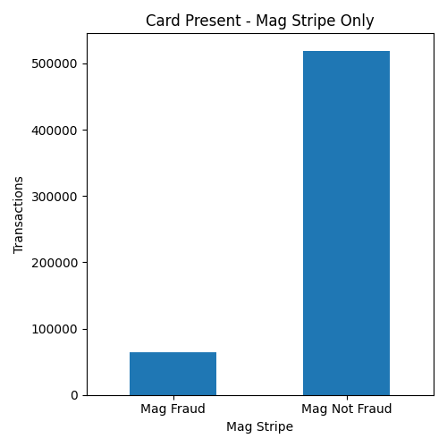
Analyzing Security Features in card present transactions:
Magnetic Stripe
The segment of transaction data set for magnetic stripe usage excluded transactions using a chip or pin for validation.
In this population of 584,046 transactions just 64,729, or 11%, were identified as fraudulent.

Slide 7
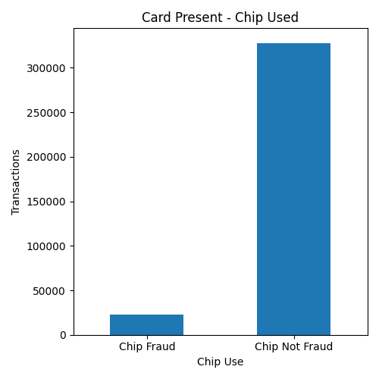
Analyzing Security Features in card present transactions:
Europay, Mastercard and Visa (EMV) Chip
The segment of transaction data set for EMV chip usage excluded transactions using the mag stripe or pin for validation.
In this population of 350,399 transactions just 22,410, or 6%, were identified as fraudulent.

Slide 8
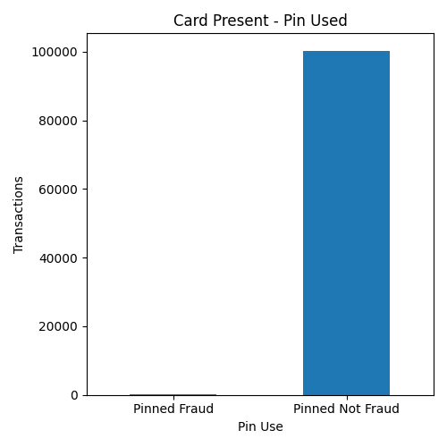
Analyzing Security Features in card present transactions:
Personal Identification Number (PIN)
The segment of transaction data set for PIN usage excluded transactions using the mag stripe or chip for validation.
In this population of 100,608 transactions just 273, or 0.3%, were identified as fraudulent.

Slide 9
Analyzing Correlation of Distance Data
The goal was to determine correlations between distance data (distance from home or last transaction) and the occurrence of fraud by analyzing various features in the dataset to identify patterns indicating fraudulent activities.

Slide 10
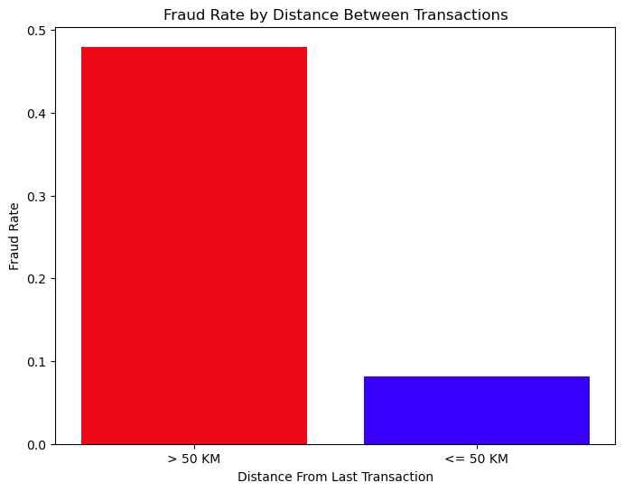
Fraud rates increase when the distance between transactions exceeds 50 KM.

Slide 11
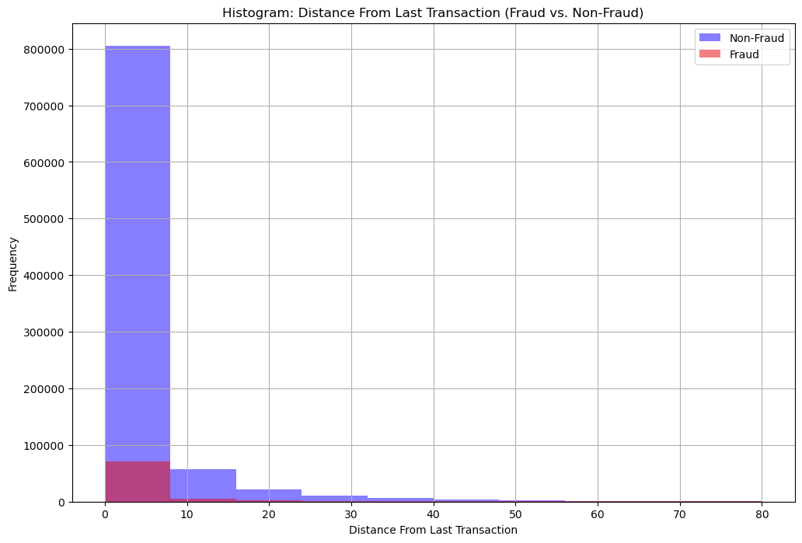
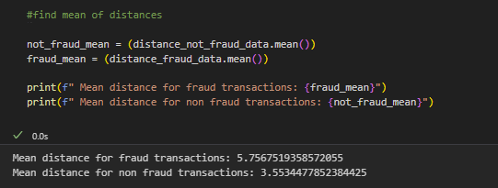
The average distance for fraudulent transactions is 5.75KM while the average for non fraudulent transactions is 3.6 KM

Slide 12
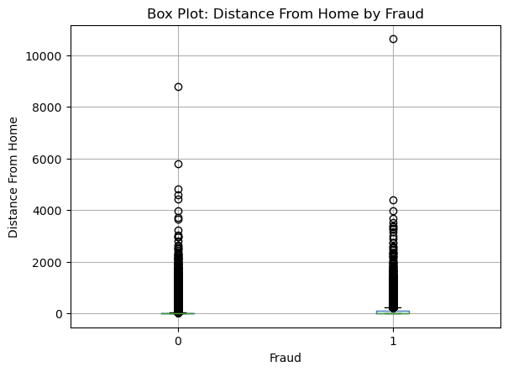
Transactions that occur further away from home are more likely to be fraudulent.

Slide 13
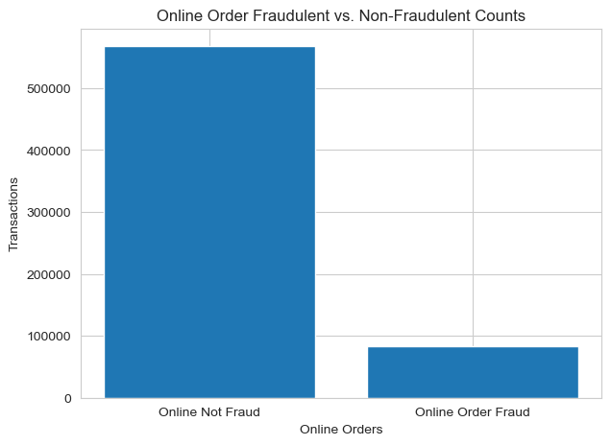
Examining transaction made online.
Out of a total of 650,552 transactions:
82,711 were identified as fraudulent (FRAUD =1), representing approximately 14.57% of a the total transactions.
The majority of transactions, 567,841, were non-fraudulent (FRAUD = 0)

Slide 14
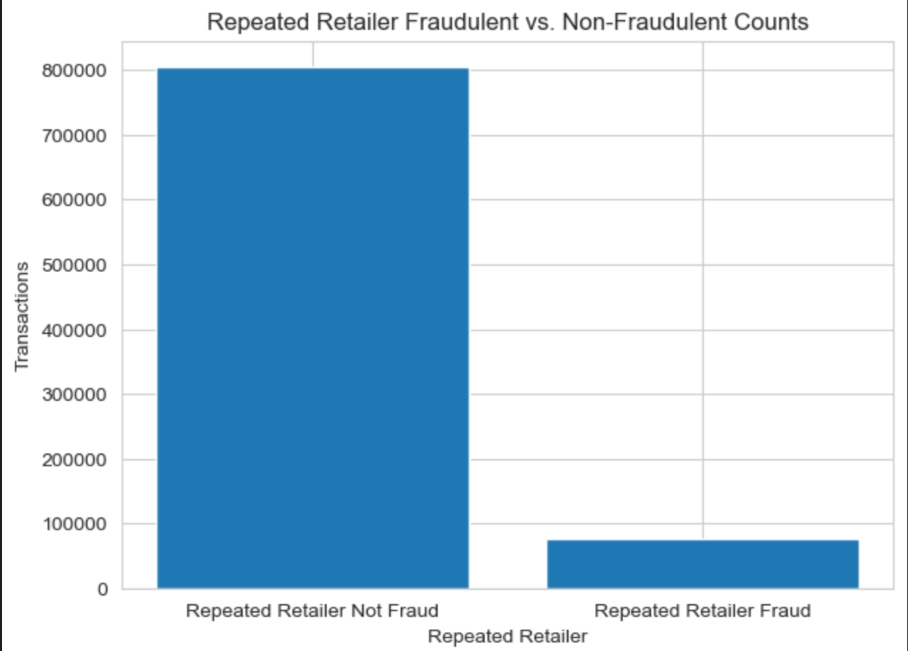
Investigating transactions from returning customers
Out of a total of 881,536 transactions:
76,925 were identified as fraudulent (FRAUD =1), representing approximately 9.56% of a the total transactions.
The majority of transactions, 804,611, were non-fraudulent (FRAUD = 0)

Slide 15
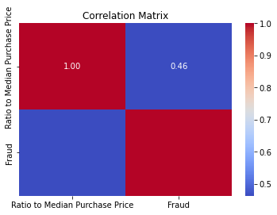
How does the ratio to median purchase price affect the probability of a fraudulent transaction?
The correlation between the ratio to median purchase price and fraud is ~.5 positive correlation.
Meaning that when the ratio to median purchase price is higher the more likely there will be fraud.

Slide 16
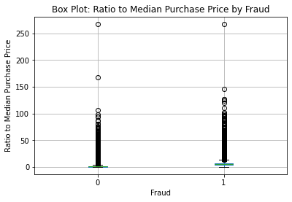
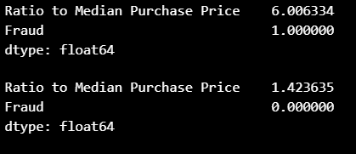
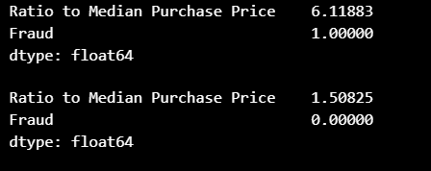
Are higher ratios to median purchase prices more indicative of fraud activity vs lower ratios?
Fraudulent vs. Non-Fraudulent
Checked Max and Min values for both dataframes.
Took the average.
Which shows that the fraudulent transactions tend to on average have higher ratios to median prices.
Unsampled
Sampled

